Slide 1
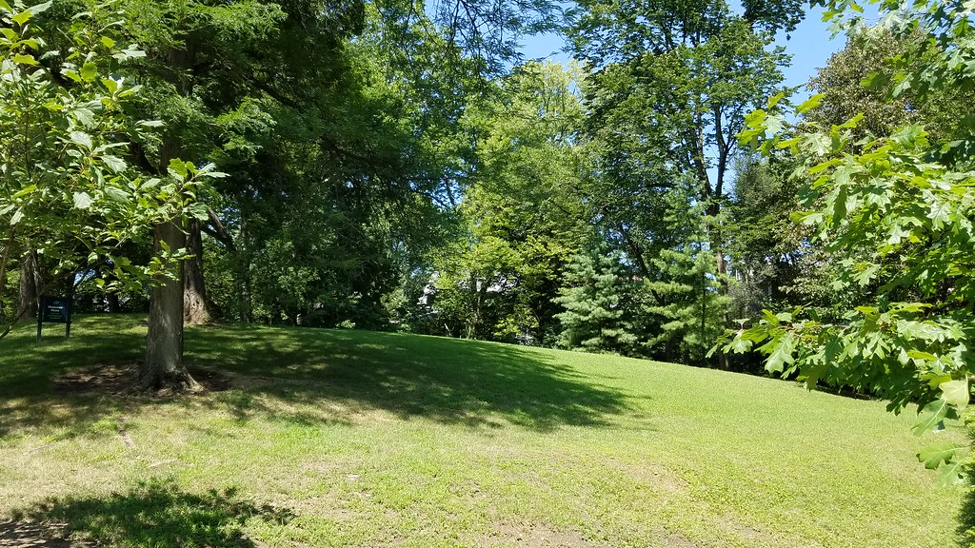
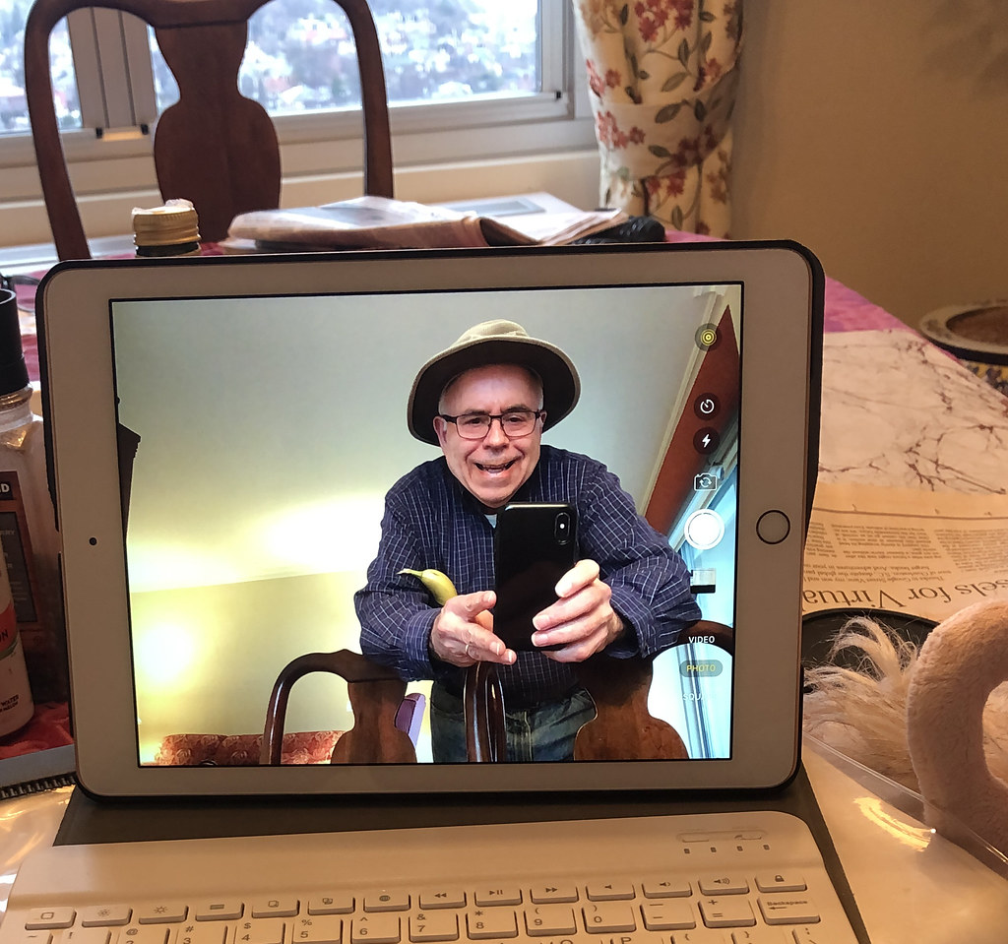
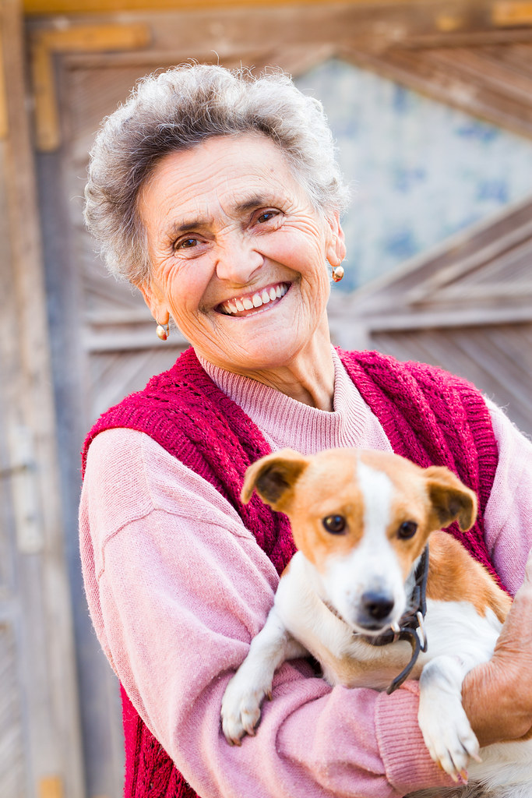
COVID-19
>65yo. most at risk
Meet
Wash your hands
Wear a mask
Exchange
Keep your distance
Promote social networks & pictures sharing
Increase calls / stay in contact
Fresh air
Outside every day
Sun & exposure to greenspace
Activities leading to mental boost
If careful & no symptoms / negative test
Aware
Show how to counter conspiracy theories
Remind them check-ups & other care
Adapt speech to the situation & be positive
Exercising
Coordinate with family members and friends
Videoconference is a plus
Talk about risks & don't treat them like kids

